Slide 1

3 rd ICOVET 2019
International Conference on Vocational Education and Training
“ Revitalizing of Vocational Education and Training for Sustainable Technology in The Industry 4.0”
Saturday, September 14, 2019
Ijen Suites Hotel, Malang, East Java, Indonesia

Slide 2
MALAYSIA SKILLS DEVELOPMENT : WHAT MATTER?

Slide 3
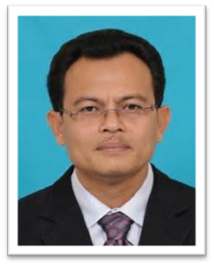
ASSOC. PROFESSOR Ts. DR. ASNUL DAHAR MINGHAT
Ph.D , M.Sc., B. Tech. Ed. (Hons) Civil Eng.,Cert. Ed. (TTTC)
Deputy Vice-Chancellor (Research and Innovation)
University College of Islam Melaka, Malaysia
asnuldahar@kuim.edu.my
Senior Lecturer, UTM Kuala Lumpur (2003-2018)
Visiting Professor, Universitas Negeri Yogyakarta, Indonesia (2018 & 2019)
Visiting Lecturer, Karamanoglu Mehmatbay University, Karaman, Turkey (2017)
Visiting Fellow, Griffith University, Queensland, Australia (2009 dan 2010)
Secretary General, Asian Academic Society for Vocational Education and Training (AASVET) 2018-2020
Board Member, Malaysia Association of Technical and Vocational Education (2015- present)
Skills Qualification:
Malaysia Skills Diploma [Construction & Structure Manager] - DKM
Malaysia Skills Certificate [Level 1] Furniture Making – SKM 1
Malaysia Skills Advance Diploma- DLKM
Vocational Training Manager (VTM)
Vocational Training Executive (VTE)
Vocational Training Officer/Operational (VTO)

Slide 4
INTRODUCTION
Technical and Vocational Education and Training (TVET) plays an important role in providing the skilled workforce required for Malaysia’s economic transformation and the next stage of her growth.
Functions as a way forward to close the gaps between economies of the globe in the 21st century, it is vital for Malaysian to meet the demands of technological complex and unique future.
The 11th Malaysia Plan (11MP) announced in May 2015 projected 1.3 million additional jobs that require TVET related skills by the year 2020 highlighting the increase number of Malaysia’s requirement in skills human base.

Slide 5
INTRODUCTION
  4. Transforming TVET is one of the game changers in the 11th Malaysia Plan to meet the demand of industry and contribute towards economic growth in view of globalisation, knowledge economy, technology advances and global labour mobility.
  5. Focus will be given to transform the TVET delivery system and increase its attractiveness as a choice for another education pathway.
  6. A Malaysian Board of Technologist (MBOT) will be established to recognise the professionalism of TVET practitioners that will enable them to demand higher wages.

Slide 6
TVET Progression in Malaysia
Two public TVET institutions were established in Malaysia in 1964 to provide training for youth namely Institut Kemahiran Belia Negara (IKBN) Dusun Tua and Institut Latihan Perindustrian (ILP) Kuala Lumpur.
Currently, more than 500 public TVET institutions provide multiple programmes at all levels of education as shown below:

Slide 7
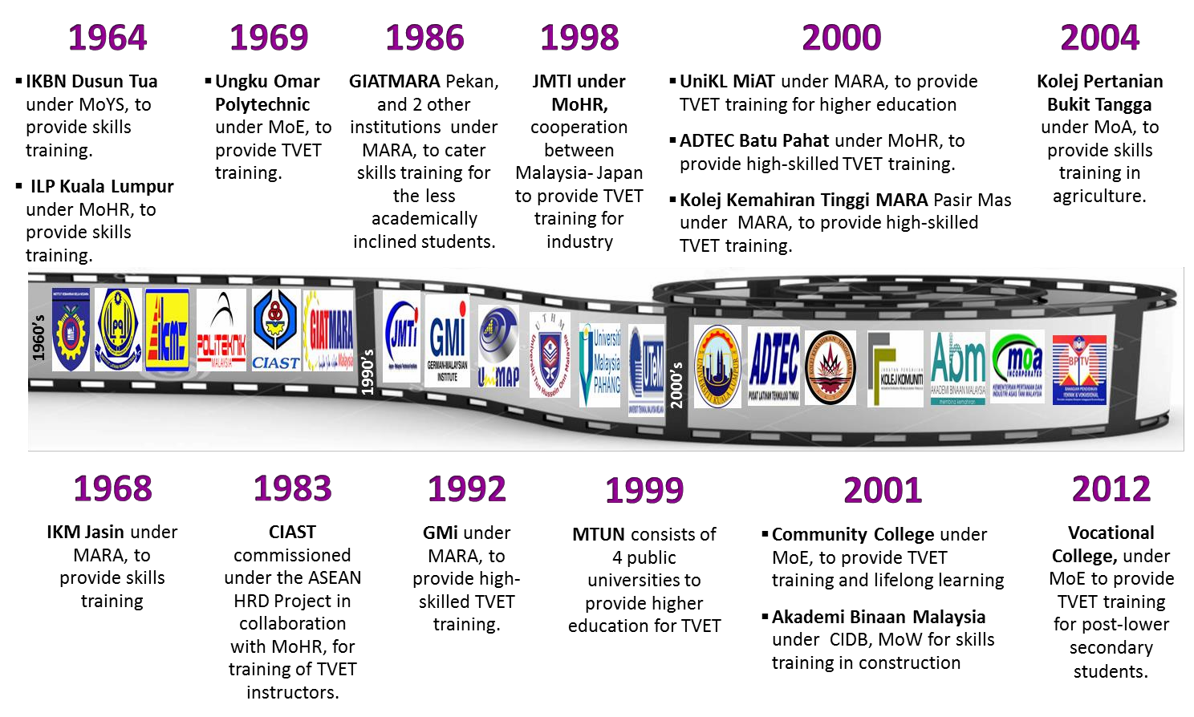
Source: The 11th Malaysia Plan, Economic Planning Unit, Prime Minister’s Department (2015)

Slide 8
WHAT IS SKILLS DEVELOMENT ?
The development of skills or competencies that are relevant to the workforce to find gainful and productive employment.
Skills are:
The capability to respond, in a practiced way, to the varying conditions and challenges posed by our situation, jobs and context and are determined by our environment to accomplish a goal or purpose

Slide 9
Where do we develop Skills?
We acquire skills through many ways at many levels:
Pre-Employment (education, training)
Employment on the job
Continuous education and training
Increasing focuses on the individual right of an individual to acquire skills and knowledge through Lifelong Learning.
Increased Emphasis: Skills Development which is relevant to Industry Needs.

Slide 10
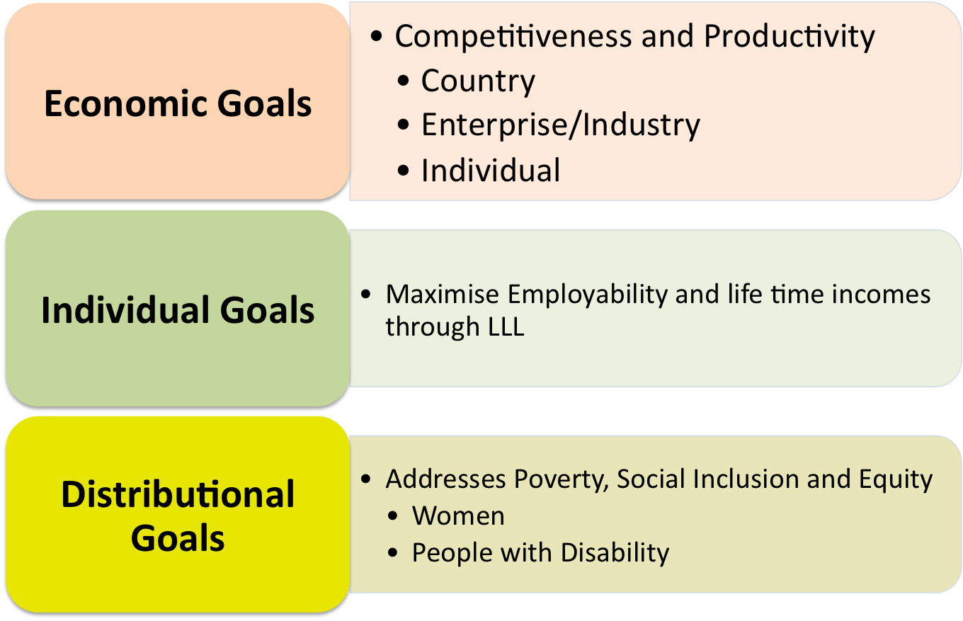
Today Skills must address

Slide 11
ACCELERATING HUMAN CAPITAL DEVELOPMENT FOR AN ADVANCED NATION
“In progressing towards an advanced nation, we will need more high-skilled workers. Therefore, the Government would like more students to pursue education in technical and vocational training and be trained and qualified. This field now comprises only 25 percent of the workforce.
...This Plan aims to boost this workforce to 35 percent, at par with academic and professional graduates.
…For this reason, Technical and Vocational Education and Training (TVET) will be strengthened.”
Source: Speech by the Prime Minister for the launch of 11th. MP on 21 May 2015.

Slide 12

Focus areas …accelerating human capital development for an advanced nation
Focus area A
Improving labour market efficiency to accelerate economic growth.
Focus area B
Transforming TVET to meet industry demand
Focus area C
Strengthening lifelong learning for skills enhancement.
Theme of 11th.MP:
Anchoring growth
on people
Focus area D
Improving quality of education for better student outcomes and institutional excellence
Source: Department of Skills Development, Ministry of Human Resources (2016)

Slide 13
Expected Outcomes: TVET under 11th Malaysia Plan
Institutions
Specialization and optimization
Programme
Industry compliance and high employability
Instructor / Lecturers
Highly skilled and better delivery
Public (Students)
Clear education pathways and employment with better income
Industry
Better engagement with institutions
Source: Department of Skills Development, Ministry of Human Resources (2016)

Slide 14
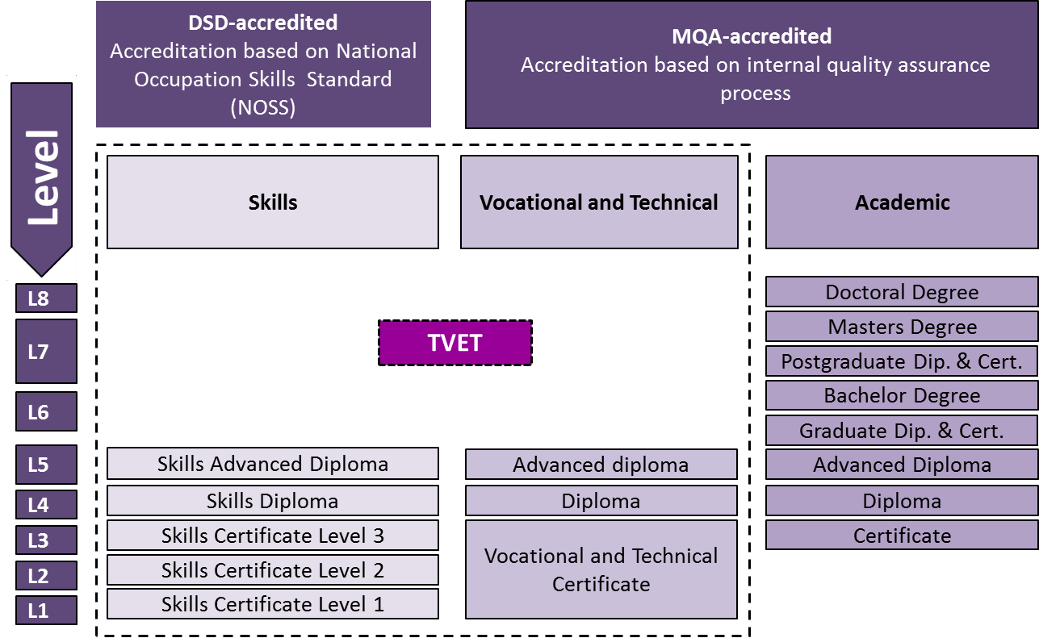
Malaysian Qualification Framework
Source: The 11th Malaysia Plan, Economic Planning Unit, Prime Minister’s Department (2015)

Slide 15
Multiplicity in governance and delivery
Certificates
offered
MOHR
MOYS
MORRD
MOE
MOA
MOPW
States
1
B Tech
UniKL / MTUN
JMTI
Adv Dip Tech
1
Polytechnic
Diploma
27
Polytechnics
KKTM⁶
Diploma
Technology
9
1
GMI⁷
IKTBN
4
1
MSAD
ADTEC
Private
Accredited
Center
1
MOA institute
(CAM)
MSD
57¹⁰
CC Cert
Community
Colleges
ILP
22
12
Tech Cert
IKM⁶
MSC 1,2,3
15
5
6
31
IKBN⁵
Vocational
Schools/ Academies
MOA Institutes
CIDB
(ABM)
States institutes
500-600
212
Private
Accredited
Centres
GiatMARA⁹
MSC 1 & 2
88
SPM
More than 1,000 institutions/providers, about 45% public institutions accounting for 70% of students with enrolment exceeding 300,000
Source: BCG 2011
Notes:
15

Slide 16
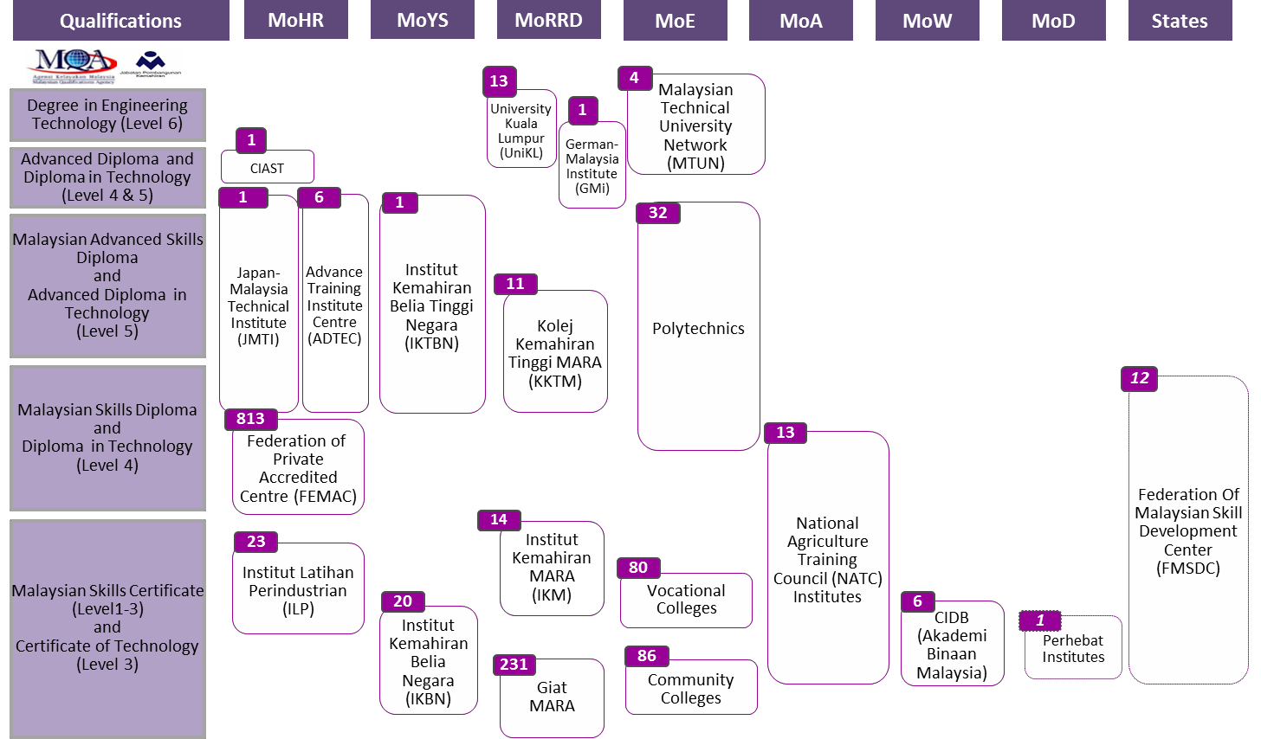
Institutions for Technical and Vocational Education and Training
Source: The 11th Malaysia Plan, Economic Planning Unit, Prime Minister’s Department (2015)

Slide 17
Various standards, accreditation & certification in Skill Sector and Vocational & Technical Sector
Skill Sector
(DSD, 652 Act)
Vocational & Technical Sector
(MQA, 670 Act)
Level 5
(Advanced Diploma)
JMTI/
ADTEC
DKM
DKLM
IKTBN
DKM
DKLM
Poli-
teknik
Diploma/
Adv. Dip
GMI
Adv. Diploma
Level 4
(Diploma)
Kolej Vokasional
SKM
DKM
Institut
Pertanian;
JKM;
ATM;
Jab Penjara
DKM
SKM
ILK/IPT
Swasta
Adv Dip
Dip
DKM/
DLKM
Sijil/SKM
KKTM
Diploma
Level 3
(Certificate)
ILP
SKM
DKM
IKBN
SKM
Kolej
Komuniti
SMKK
IKM
Sijil MARA
Level 2
(Certificate)
CIDB
SKK
GiatMARA
SKM & Sijil MARA
Level 1
(Certificate)
KSM
KPM
KBS
KPIAT/KDN/KP
KPM
KKLW
KKR
KKLW
Note Skills Sector using credentials
under the Malaysian Skills Certification System
operated by the DSD.

Slide 18
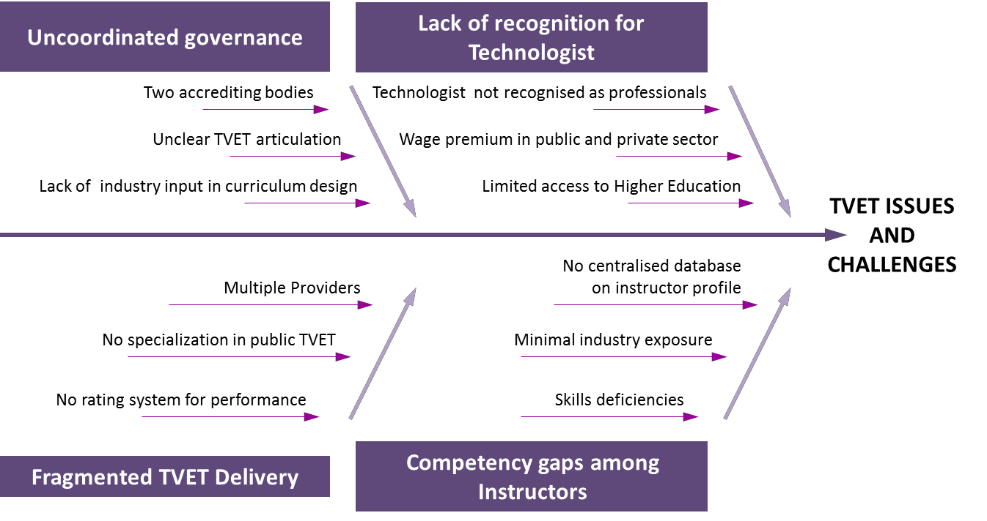
TVET Issues and Challenges
Source: The 11th Malaysia Plan, Economic Planning Unit, Prime Minister’s Department (2015)

Slide 19
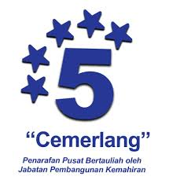
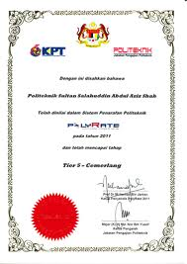



Strengthening TVET governance
Establishing a Single System for Accreditation
Harmonising TVET Institutions Rating Systems to Improve Comparability
1
2
TVET
L8
Doctoral Degree
Masters Degree
Bachelor Degree
Advanced Diploma
Diploma
Star Rating (JPK)
Certificate Level 3
PolyRate (Politeknik)
Certificate Level 2
L1
Certificate Level 1
Harmonised single rating system
Single & independent quality assurance
MySpeKK (Community College)
&
Source: DSD, MOHR (2016)

Slide 20
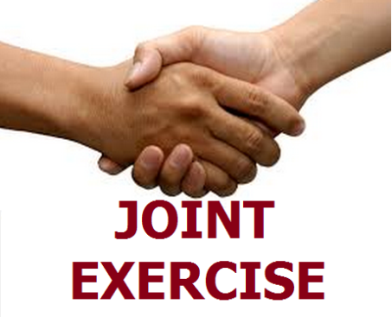

A new comprehensive model…..
NATIONAL HUMAN CAPITAL DEVELOPMENT COUNCIL
Demand Side
Supply Side
Performance Monitoring
Industry Skills Committee (ISC)
Majlis Kemahiran Industri
Providers
Performance Committee
JPK & MQA
Quality Assurance & Qualifications
PHASE 1:
2015 - 2016
PHASE 2:
2017 AND BEYOND
Professional /Regulatory Bodies
Source: DSD, MOHR (2016)

Slide 21
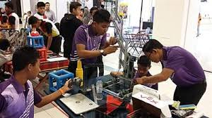
Skills & Talent
Skills and talent have become the major ingredients for Malaysia to become a high-income economy by 2020. The key objective is to develop a highly skilled workforce.
Source: DSD, MOHR (2016)

Slide 22
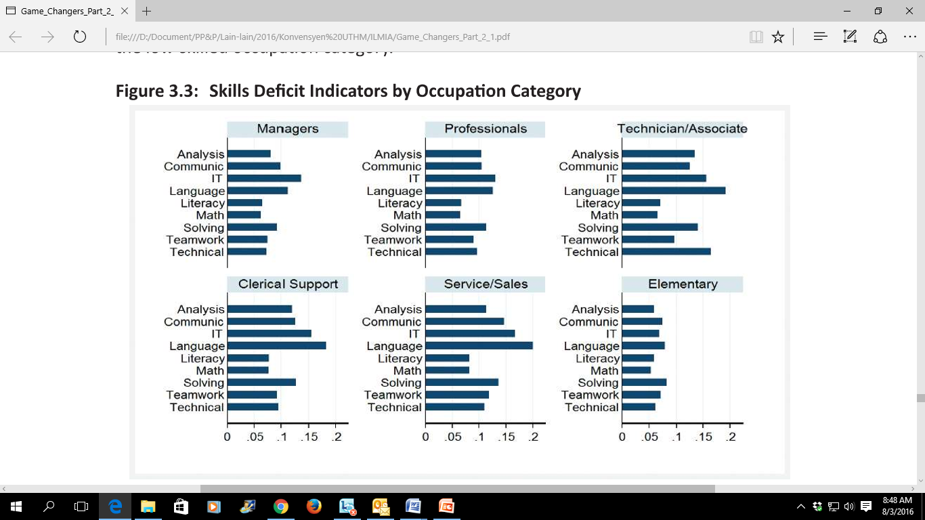
SKILLS INDEX
As a person’s skills are manifested in the competency in performing a job, the National Employment Returns (2011) has reported on skill deficits based on MASCO occupational categories for NKEA sectors. Based on Figure 3.3, information technology and language skills are the main skills deficit experienced by the high and mid-skilled occupation categories while problem solving and language skills are the main deficit faced by the low-skilled occupation category.
Figure 3.3: Skills Deficit Indicators by Occupation Category
Notes: Based on MASCO classifications, Managers, Professionals, Technician/ Associate, Clerical support, Service/Sales and Elementary refer to category 1,2,3,4,5 and 9 respectively. Source: World Bank, Developing Skills for Innovation and High Income Economy in Malaysia, 2013
Source: DSD, MOHR (2016)

Slide 23
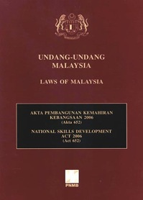

Akta 652
Diwartakan pada 29 Jun 2006
Mandat:
  Membangunkan National Occupational Skills Standards (NOSS)
  Menggunakan NOSS untuk:
    Mentauliah program kemahiran;
    Mempersijilkan individu dengan SKM/DKM/DLKM
19

Slide 24
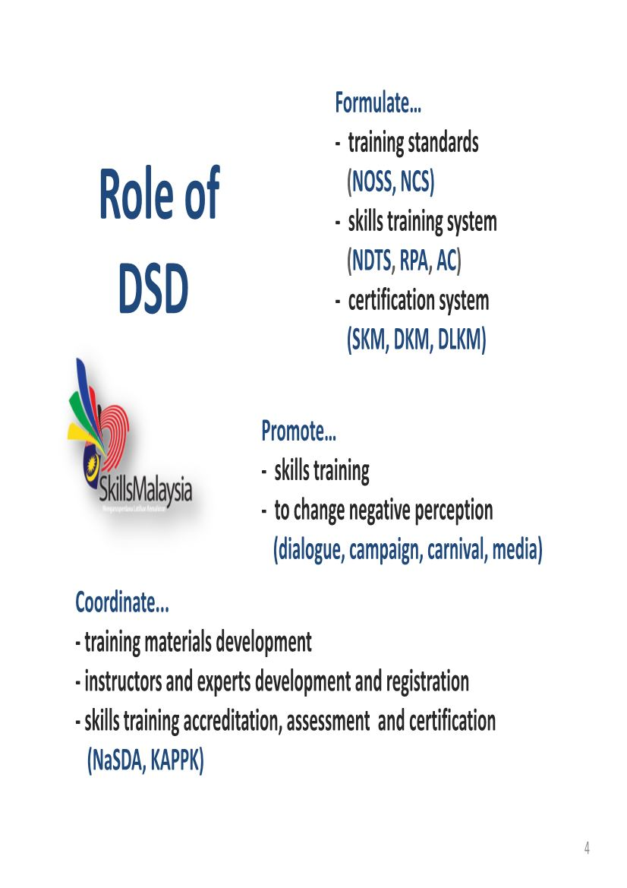
Role & Function of DSD
DEVELOP NATIONAL OCCUPATIONAL SKILLS STANDARD
REGULATE NATIONAL TRAINING CERTIFICATION SYSTEM
COORDINATE THE DEVELOPMENT OF TRAINERS FOR SKILLS TRAINING
PROMOTE SKILLS TRAINING
MANAGE THE POOL OF NATIONAL INDUSTRY EXPERT (DPIN)
CERTIFY SKILLED WORKERS
SPEARHEAD R&D IN SKILLS TRAINING
ROLE
FUNCTION
Source: DSD, MOHR (2016)

Slide 25
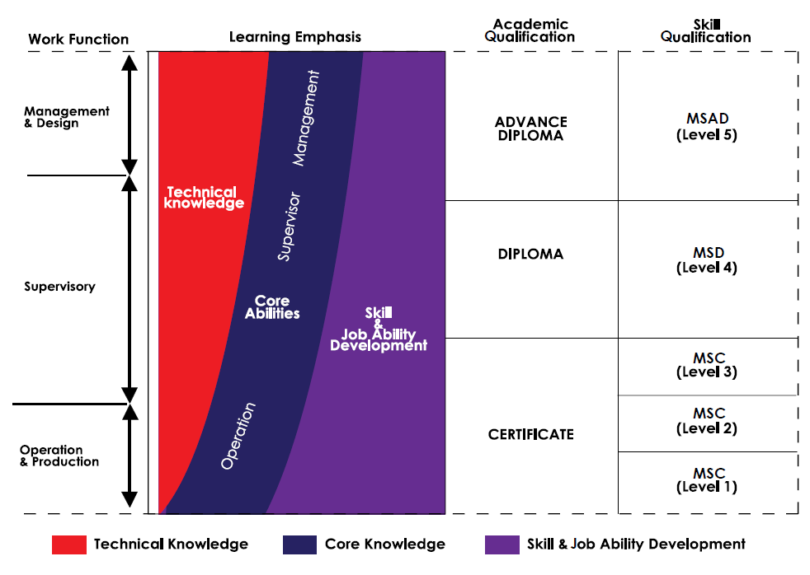
Malaysian Occupational Skills Qualification Framework (MOSQF)
Source: DSD, MOHR (2016)

Slide 26
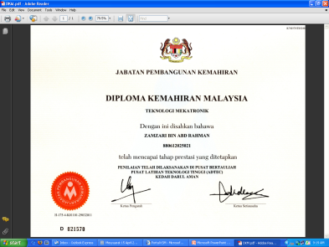

Malaysian Skills Certification System:
3 main approaches
1
2
National Dual Training System
Sistem Latihan Dual Nasional (SLDN)‏
30% in workplaces and 70% in training institutions.
Accredited Centres &
Programmes
3
Recognition of Prior Achievement.
Pengiktirafan Pencapaian Terdahulu (PPT)‏
Source: DSD, MOHR (2016)
Notes:
26

Slide 27
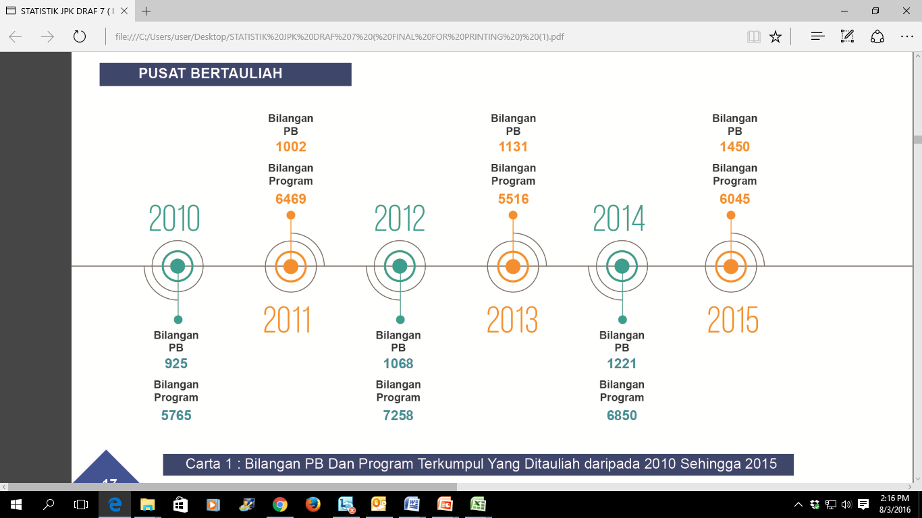
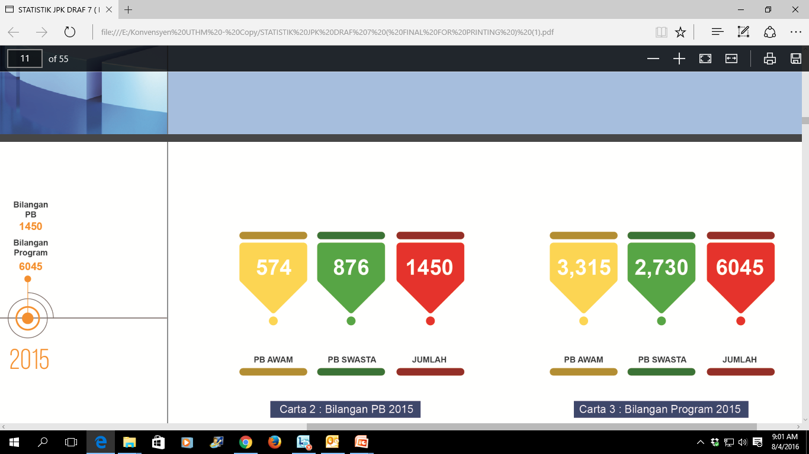
Malaysian Skills Certification System
ACCREDITED CENTRE
Attend full time course at JPK’s Accredited Centre
1002 Accredited Center
6469
Programs
1131 Accredited Center
5516
Programs
1450 Accredited Center
6045
Programs
NATIONAL DUAL TRAINING SYSTEM
(NDTS)‏
2010
2012
2014
2016
Industry Based Training (Train your employees at their workplace)
2011
2013
2015
RECOGNITION OF PRIOR ACHIEVEMENTS (RPA)‏
925 Accredited Center
5765
Programs
1068 Accredited Center
7258
Programs
1221 Accredited Center
6850
Programs
1184 Accredited Center
1499
Programs
Tell us your working experiences and we get you certified
Cumulative numbers of Accredited Centre and Programs from 2010 - Jun 2016
541
643
1184
343
1156
1499
Cumulative numbers of Accredited Centre from 2010 - Jun 2016
Cumulative numbers of Programs from 2010 - Jun 2016
Source: DSD, MOHR (2016)

Slide 28


  RECOGNITION
Technical & Vocational Education Division (BPTV), Ministry of Education
66 JPA Scheme adopt Sijil Kemahiran Malaysia qualification
Malaysia Board of Technologist (MBOT) – Skilled Accreditation Council (SAC)
Artikulasi bagi kemasukan ke MTUN dan IPTS
Source: DSD, MOHR (2016)

Slide 29
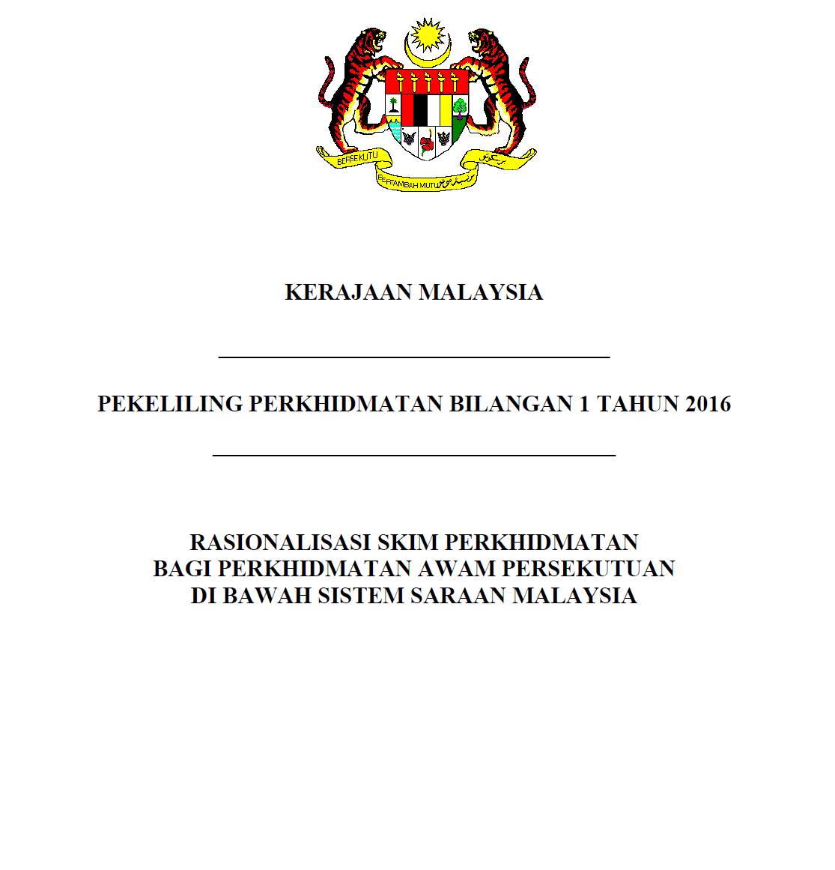
PEKELILING PERKHIDMATAN AWAM BIL.1/2016

Slide 30
66 SKIM PERKHIDMATAN
64 KELAYAKAN SKM
2 KELAYAKAN DKM

Slide 31

66 SKIM PERKHIDMATAN MENGGUNAKAN SKM/DKM
Bil. | Skim Perkhidmatan | Gred | Sedia Ada/ Baharu
1 | Pemeriksa Kereta Motor | AB19 | Sedia Ada
2 | Ahli Muzik | B19 | Sedia Ada
3 | Jurufotografi | B19 | Sedia Ada
4 | Jurusolek | B19 | Sedia Ada
5 | Pereka | B19 | Sedia Ada
6 | Pembantu Pegawai Latihan | E19 | Sedia Ada
 | Penolong Pegawai Latihan | E29 | Baharu
7 | Juruteknik Komputer | FT19 | Sedia Ada
8 | Pembantu Perikanan | G19 | Sedia Ada
9 | Penyelia Rancangan Tanah | G19 | Sedia Ada
10 | Pembantu Kemahiran | H19 | Sedia Ada
11 | Pelukis Pelan (Kejuruteraan Awam)/Penolong Jurutera | JA19 | Sedia Ada
12 | Pelukis Pelan (Seni Bina)/Penolong Pegawai Seni Bina | JA19 | Sedia Ada
13 | Pembantu Pegawai Latihan Vokasional | DV19 | Sedia Ada
 | Penolong Pegawai Latihan Vokasional | DV29 | Baharu
14 | Juruaudio Visual | N19 | Sedia Ada
15 | Pembantu Penyediaan Makanan | N19 | Sedia Ada
16 | Penerbit Rancangan | B19 | Baharu
17 | Artis Budaya | B19 | Baharu
18 | Pegawai Kebudayaan | B19 | Baharu
19 | Pembantu Makmal | C19 | Baharu
20 | Pembantu Makmal Filem | C19 | Baharu
21 | Pembantu Geosains | C19 | Baharu
22 | Pembantu Perangkaan | E19 | Baharu
23 | Pembantu Ehwal Ekonomi | E19 | Baharu
24 | Pembantu Taman/Ladang | G19 | Baharu
25 | Pembantu Veterinar/Penolong Pegawai Veterinar | G19 | Baharu

Slide 32

66 SKIM PERKHIDMATAN MENGGUNAKAN SKM/DKM
Bil. | Skim Perkhidmatan | Gred | Sedia Ada/ Baharu
26 | Pembantu Hidupan Liar | G19 | Baharu
27 | Pembantu Pemeriksa Kilang dan Jentera | J19 | Baharu
28 | Penguasa Bekalan Air | J19 | Baharu
29 | Merinyu Tali Air | J19 | Baharu
30 | Pegawai Bomba | KB19 | Baharu
31 | Pembantu Keselamatan | KP19 | Baharu
32 | Pembantu Pertahanan Awam | KP19 | Baharu
33 | Pembantu Pendaftaran | KP19 | Baharu
34 | Pegawai Imigresen | KP19 | Baharu
35 | Pegawai Penjara | KA19 | Baharu
36 | Pembantu Tadbir (Undang-undang) | L19 | Baharu
37 | Pembantu Syariah | LS19 | Baharu
38 | Jurubahasa | L19 | Baharu
39 | Pembantu Tadbir (Perkeranian/Operasi) | N19 | Baharu
40 | Pembantu Penguat Kuasa | KP19 | Baharu
41 | Pembantu Penerbitan | N19 | Baharu
42 | Pemeriksa Cap Jari | N19 | Baharu
43 | Pegawai Khidmat Pelanggan | N19 | Baharu
44 | Pembantu Setiausaha Pejabat/Setiausaha Pejabat | N19 | Baharu
45 | Pembantu Pentadbir Tanah/Penolong Pentadbir Tanah | NT19 | Baharu
46 | Penyelia Asrama | N19 | Baharu
47 | Operator Wayarles | N19 | Baharu
48 | Pembantu Penyelidik Sosial | N19 | Baharu
49 | Pembantu Pengurusan Murid | N19 | Baharu
50 | Pembantu Hal Ehwal Islam | S19 | Baharu
Source: DSD, MOHR (2016)

Slide 33

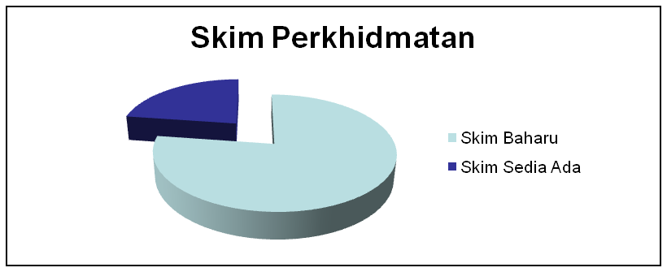
66 SKIM PERKHIDMATAN MENGGUNAKAN SKM/DKM
Bil. | Skim Perkhidmatan | Gred | Sedia Ada/ Baharu
51 | Pembantu Arkib | S19 | Baharu
52 | Pembantu Pemuliharaan | S19 | Baharu
53 | Pembantu Muzium | S19 | Baharu
54 | Pembantu Pustakawan | S19 | Baharu
55 | Pembantu Pembangunan Masyarakat | S19 | Baharu
56 | Pembantu Belia dan Sukan | S19 | Baharu
57 | Pembantu Perhubungan Perusahaan | S19 | Baharu
58 | Pembantu Penerangan | S19 | Baharu
59 | Pembantu Antidadah | S19 | Baharu
60 | Pembantu Kesatria | S19 | Baharu
61 | Pembantu Penyelidik | Q19 | Baharu
62 | Pembantu Akauntan | W19 | Baharu
63 | Pembantu Penilaian | W19 | Baharu
64 | Pembantu Juruaudit | W19 | Baharu
65 | Pembantu Tadbir (Kewangan) | W19 | Baharu
66 | Pembantu Penguasa Kastam | WK19 | Baharu
15
51
Source: DSD, MOHR (2016)

Slide 34
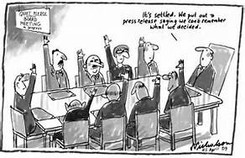
RECOGNITION
Malaysia Board of Technologist (MBOT) – Skilled Accreditation Council (SAC) – Chair by DSD Director General
Malaysia Board of Technologists (MBOT) currently being established under Technologists and Technicians Act 2015 [Act 768] gazetted 4 Jun 2015 as an apex body to recognise the professionalism of technologists, similar to Board of Engineers (for engineering profession).
MBOT will serve to elevate the technologist professional career advancement and for industry acceptance. MBOT will also provide advice on wage structure for technologists as reference for public and private employers. It will also be the professional body to govern professional ethics and conducts of technologists.
Target Group:
Promotional efforts are underway to attract graduates of technical universities, polytechnics and holder of Malaysian Skills Certificate (SKM), Malaysian Skills Diploma (DKM) and Malaysian Skills Advance Diploma (DLKM) accredited by Department of Skills Development (DSD) to register as a member of the MBOT.

Slide 35
PROFESSIONAL DEVELOPMENT
Industrial Attachment
Skills Upgrading
Qualification Upgrading
PROFESSIONAL DEVELOPMENT

Slide 36



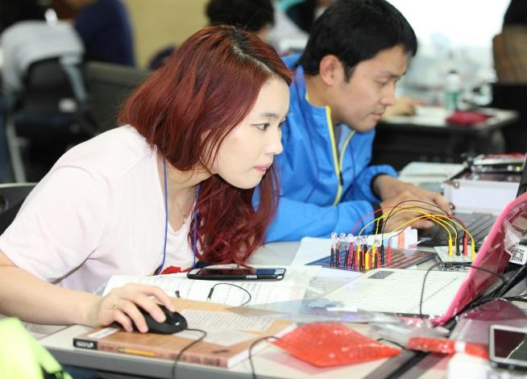



Why Important
Strengthen crucial technical & soft skills
Navigate through career smoothy
Increase marketability for employers
Invaluable personal network

Slide 37
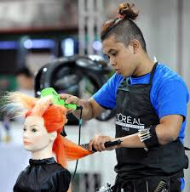







Conclusion
Competent and practical in field
Skilled Workers Features
Ability to solve problems
Can communicate well
Positive Attitude
Computer skills
Ability to make decisions
Can work in groups
Souce: ILO, 2007

Slide 38
THANK YOU!

