Slide 1

Curriculum Reform of Vocational Senior High School in Taiwan
Yi-Fang Lee
Professor
Department of Industrial Education
National Taiwan Normal University
2019.9.14

Slide 2
CONTENTS
Introduction/Background
Revision Process
Fundamental Beliefs and Goals of the Curriculum
Core Competency
Curriculum Framework
Focus of the VSHS Curriculum Reform
Challenges for Curriculum Implementation

Slide 3
Introduction of the background
In recent years, issues of significance have emerged in Taiwan that demonstrate that education must keep pace with changing social needs and global trends.
Taiwan has launched a 12-Year Basic Education Implementation Plan in 2014 that extended the number of years of basic national education from 9 to 12.
A 12-year Basic Education Curriculum was developed to improve core competencies among citizens in relation to the needs of an evolving society.
By the end of 2018, new curriculum guidelines were promulgated by MOE and started to be used in the 2019 academic year.

Slide 4
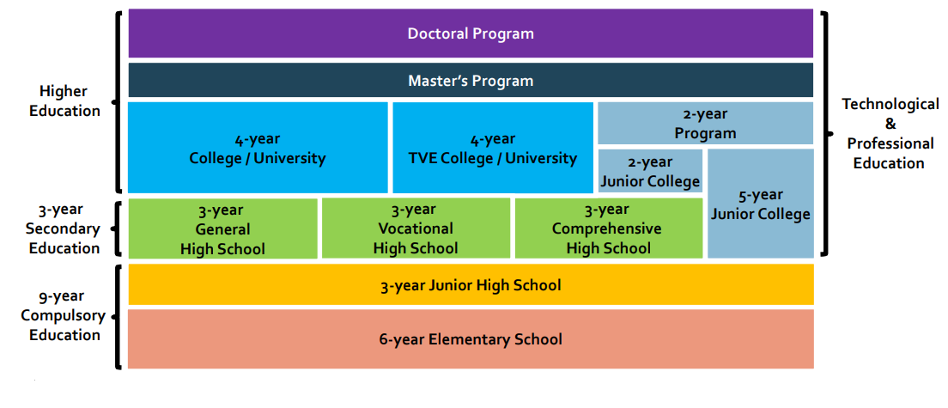
Current education system in Taiwan

Slide 5
II. Revision Process
Process took around 6 years, 2013 - 2018.
In 2013, the National Academy for Educational Research (NAER) and the Department of Technological and Vocational Education (of the MOE) were charged with producing the 12-Year Basic Education curriculum.
In 2014, a General Guideline was generated as the basis for elementary, junior high, and upper secondary school revisions. For the VSHS curriculum, each vocational cluster has its own guideline leading to 15 versions.
During the revision process, the 12-Year Basic Education Curriculum Research and Development Committee (of the NAER) oversaw the drafting of the curriculum.
After that, the 12-Year Basic Education Curriculum Review Committee was responsible for reviewing the drafted curriculum

Slide 6
III. Beliefs and Goals of the Curriculum
To develop talent in every student, to nurture their inherent abilities, and promote life-long learning
VISION
Taking the initiative
engaging in public
seeking the common good
BELIEFS
Inspiring students to achieve their full potential
Teach and develop knowledge about life
Promote career development
Inculcate civic responsibility
GOALS
Source：guide.hcc.edu.tw/ezfiles/138/1138/img/1526/582847417.pptx

Slide 7



Taking the initiative
Engaging in public
Seeking the common good
To develop learners’ individuality by enhancing motivation and passion for learning, fulfilled learning, and self-confidence
To empower leaners to explore the world via connecting with people, environment, and difference cultures
To ensure individual well-being and promote universal harmony
Source：guide.hcc.edu.tw/ezfiles/138/1138/img/1526/582847417.pptx

Slide 8
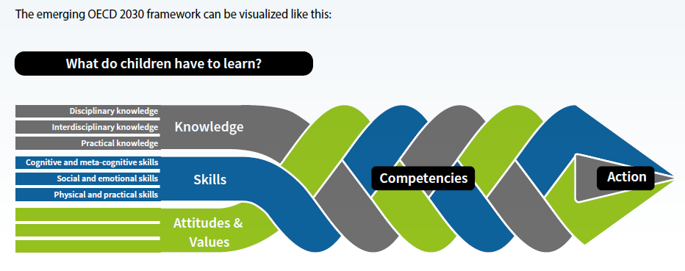
IV Core Competency: what do children have to learn?
OECD Future of Education and Skills 2030: The aim of the project is to help countries find answers to two far-reaching questions:
What knowledge, skills, attitudes and values will today's students need to thrive and shape their world?
How can instructional systems develop these knowledge, skills, attitudes and values effectively?
Source：https://www.oecd.org/education/2030/E2030%20Position%20Paper%20(05.04.2018).pdf

Slide 9
Core Competency in new curriculum：
encompasses information, ability, and attitude that a person should possess to equip him or her for daily life and for tackling future challenges
learning should not be limited to the knowledge and ability taught in school
instead, learning should consider real-life scenarios and stress holistic development through action and self-development
Three Dimensions
Communication and Interaction
Spontaneity
Lifelong Learner
Social Participation
Source：guide.hcc.edu.tw/ezfiles/138/1138/img/1526/582847417.pptx

Slide 10
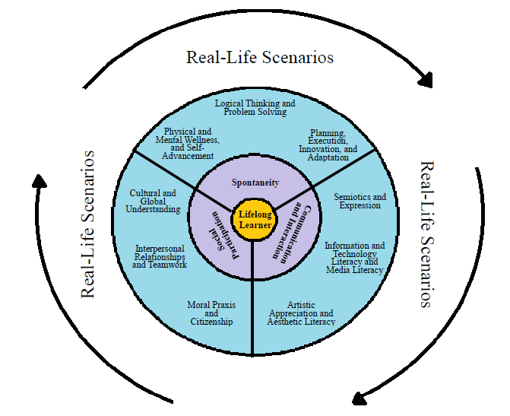
Three Dimensions And Nine Items of Core Competencies
Core competencies are used as the basis of curriculum development.
They ensure continuity between educational stages, bridge and integrate between domains and subjects
Wheel-in-action diagram of core competencies
Source：https://www.naer.edu.tw/ezfiles/0/1000/img/52/129488083.pdf

Slide 11

V. Curriculum Framework
The 12-Year Basic Education Curriculum is classified into two types
School-developed curriculum
（Alternative curriculum）
designed and offered by each school to highlight the school vision of education and facilitate students’ development foundation according to their aptitudes
MOE-mandated curriculum
（Domain-specific curriculum ）
planned by the government to develop basic learning ability and establish a development foundation according to student aptitudes.
From：WU,YUE-LING

Slide 12
Curriculum types for each educational stage
Curriculum types Educational stage |  | MOE-mandated curriculum | School-developed curriculum
Elementary school |  | Domain-specific curriculum | Alternative curriculum
Junior high school
Upper secondary school | General senior high school | General subjects Vocational subjects Hand-on courses | School-developed required courses Elective courses Group activity period Alternative learning period
 | Vocational senior high school
 | Comprehensive senior high school
 | Specialized senior high school
Source：https://www.naer.edu.tw/ezfiles/0/1000/img/52/129488083.pdf

Slide 13
General subjects in MOE-mandated curriculum
Language Arts
Health and Physical education
Mathematics
8 major domains curriculum
Technology
Social Studies
Integrative Activities
Natural Sciences
Arts
Source：guide.hcc.edu.tw/ezfiles/138/1138/img/1526/582847417.pptx

Slide 14
Vocational and hand-on subjects in MOE-mandated curriculum
There are 15 clusters in the VSHS that offer basic and specialized programs to meet the demands of the industrial, commerce, agriculture, domestic life, art, and marine products sectors.
A curriculum guideline has been designed to meet the specific needs of each cluster.
Each school should have professional and practicum courses for all skill domains from each cluster.
Ministry-mandated professional courses and practicum courses should be in the range of 45 to 60 credits. The number is an increase from the 15 to 30 credits previously to ensure students’ practical ability.

Slide 15
Educational
Stage
Vocational Senior High School
(VSHS)
School-based courses must integrate MOE-mandated curriculum and school-developed curriculum appropriately
Curriculum
Type
MOE-mandated
School-developed
Main
Project
General subject
Vocational subjects
Practicum courses
School-
developed
required
courses
School-
developed elective
courses
Group
Activity/
Alternative learning
MOE-mandated
Increasing the vocational subjects and practicum courses to strengthen practical ability
School-developed
Increasing alternative learning period (self-directed learning, athlete training, enrichment education and remedial education) to encourage self-directed learning
Source：guide.hcc.edu.tw/ezfiles/138/1138/img/1526/582847417.pptx

Slide 16
VI Focus of the VSHS Curriculum Reform
Rethinking the learning conception
Student-centered teaching and learning
Students have more opportunities to take courses of interest
adoption of core competencies at each educational stage
They are considered when devising curricula, administering learning
programs, and conducting relevant assessments
Rethinking the goals and content of school subjects
Rethinking students’ learning flexibility
Alternative learning period with 6-12 credits in total was required that offers distinctive activities or elective courses to encourage self-directed learning
Strengthening hand-on ability
Increasing the vocational subjects and practicum courses (15-30 credits among different clusters) to strengthen practical ability
Source：guide.hcc.edu.tw/ezfiles/138/1138/img/1526/582847417.pptx

Slide 17
VII Lessons Learned and Challenges
for Curriculum Implementation
To promote learning progression as well as cross-field integration that fit for future needs
To emphasize the application of learned knowledge to real life scenarios that ensures all-around development of learners
To highlight school-based curriculum to bring out their unique features by integrating school visions with community resources.
To make the reform successful, the government set up strategies and support systems, such as regulation revision, pilot school implementation, principal/teacher training, and budget subsidies for equipment improvement and course development

Slide 18
VII Lessons Learned and Challenges for Curriculum Implementation
However, there are many challenges: the major one is the teacher readiness and engagement for the new curriculum
How to keep teachers up-to-date with this latest reform and ensure that they have the ability to practice the ideas?
How to evaluate curriculum outcomes, especially for students’ core competencies?
How is local school curriculum development funded?
What is their capacity to do so?
How much time and resources were put into this effort and how much now is it being funded?
How to monitor the curriculum implementation process?
How is the curriculum to be maintained/upgraded in re to fast moving fields?

Slide 19
VII Lessons Learned and Challenges for Curriculum Implementation
More effort in teacher training is needed to facilitate teachers in re to curricular changes/implementation
A mechanism must be established to evaluate and monitor the implementation process and outcome of curriculum reform at the national and school level
Need stronger support system from central government to local school
More teacher's professional learning communities are encouraged to set up and share teaching experience

Slide 20
Thanks for your listening

