Slide 1

RAVTE
Exclusive Information Meeting with the delegation from DLR and BIBB Germany
October 11th, 2019
RMUTT Thanyaburi / Thailand
RAVTE Strategy Plan 2019-23 – Strategy and Impact in the Region
Dr. Rolf Gennrich / AB-Member

Slide 2
Content
RAVTE - at a Glance (Status quo)
Challenges for TVET in the Region
RAVTE Operations and Impact in the Region
RAVTE Strategy Plan 2019-23
Cross-regional cooperation and research
Summary

Slide 3
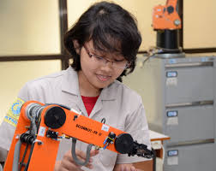

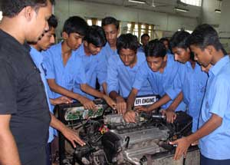
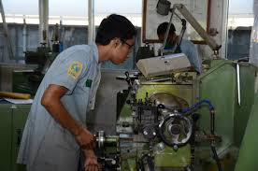
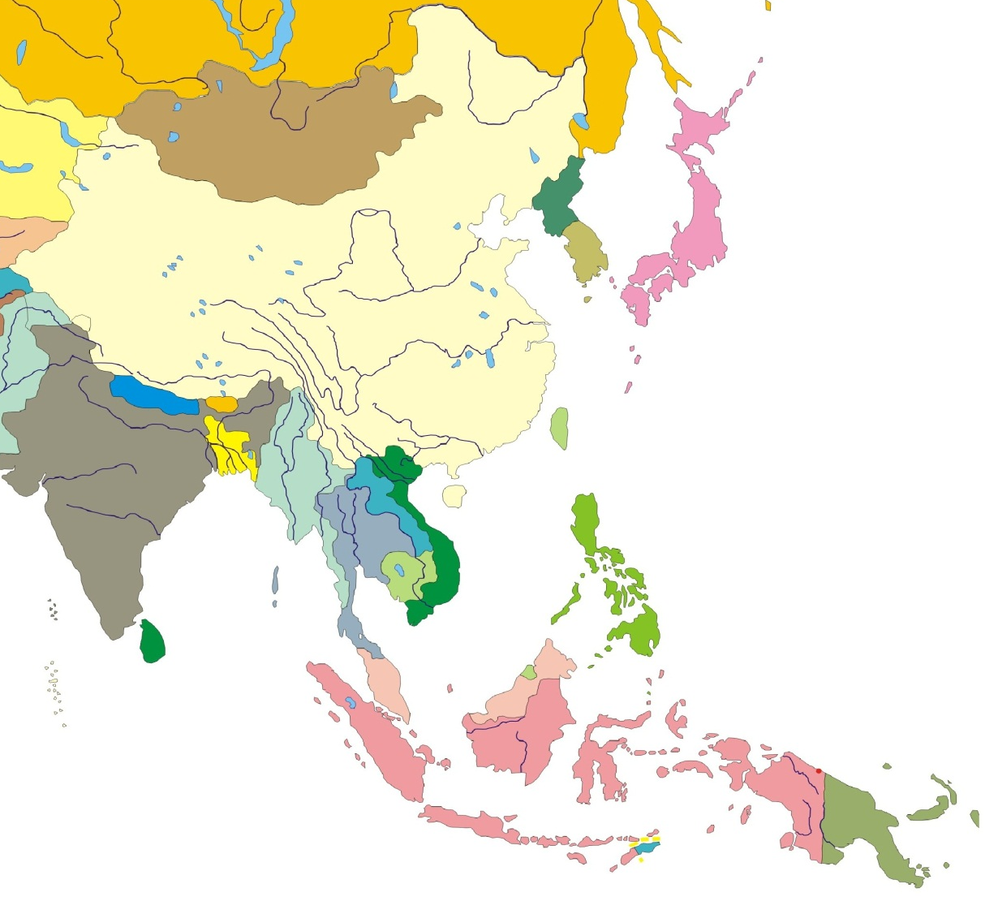
1. RAVTE - at a Glance
Abstract
The “Regional Association for Vocational & Technical Education” (RAVTE) is an exclusive and independent regional body in ASIA focussed on ASEAN integration and harmonisation of TVET
RAVTE have its routs in the German Cooperation supported RCP-Project 2011-2014 in Shanghai (with 9 Members)
RAVTE has been founded in March 2014 in Chiang Mai at RMUTL by 14 founding members
RAVTE has been successfully established as an Regional Association from 2014-2018 under the lead of RMUTL
RAVTE 2nd Presidency Period (2018-2022) started in March 12, 2018: Handover Ceremony of at RMUTT (27 members)
Since March 2018 RAVTE secretariat moved to Rajamangala University of Technology Thanyaburi (RMUTT)
RAVTE consists now on 27 members from 9 ASEAN countries
China
Laos
Thailand
Vietnam
Philippines
Cambodia
Malaysia
Singapore
Indonesia
Notes:
RAVTE is the only self-financed Regional TVET Network in the ASEAN region.
RAVTE is committed to the process of ASEAN integration on all levels, and therefore committed to harmonisation and standardisation and the establishment of a mutual government and stakeholder initiative in TVET in the ASEAN region.

Slide 4
1. RAVTE status quo (2014-2019)
Current performance status of RAVTE
Level | Rating according to DAC criteria
Level 1 | The project has no impact or the situation has actually deteriorated
Level 2 | Clearly inadequate result – despite some positive partial results, the negative results clearly dominate
Level 3 | Unsatisfactory results – significantly below expectations, despite some positive developments
Level 4 | Satisfactory result – project falls short of expectations but the positive results dominate
Level 5 | Good result, fully in line with expectations and without any significant shortcomings
Level 6 | Very good result that clearly exceeds expectations
^{[1]} OECD DAC-Rating system

Slide 5
2. Challenges for TVET in the ASEAN Region
Sustained high economic growth and employment (between 2,5 to 7,5 %)
Integrity, Mobility (AEC since 2016)
Economic large-scale projects:
  Pan-Asia Railway Network (Railway links between China and SEA)
  Economic Corridors (e.g.: Thailand /Laos/ Vietnam)
  Etc.
TVET Harmonisation and Standardisation (key word: ASEAN Mutual Recognition Arrangement - MRA)
Digitalisation and Automation
Social security / Climate change etc.
Notes:
Some topics only:
TVET have to respond to sustained high economic growth and respective employment

Slide 6
3. RAVTE Operations and Impact in the Region
University level: (RMUTT)
Contributes to enhance quality and relevance of science and research at the university
Improving scientific nature and quality of TVET programs including management and teaching staff at the Faculty of Technical Education
Increasing image and attractiveness of RMUTT (including the support to increase the demand on TVET study programs at RMUT)
Impact on national level:
Supports to TVET government policy and decision making processes in Thailand (OVEC / OHEC …?)
Transfer best practices from the international research work and discussion into the national development debate as well as into the practice of TVET implementation
RMUTT-Thailand became a regional hub for research and scientific cooperation
Regional impact:
RAVTE generates a positive TVET image regionally as well as internationally
RAVTE represents one excellent support to achieve the goals and targets of AEC (SOM-ED, SEAMEO, SEA-TVET etc.)
Capitalise cross-regional cooperation and harmonisation: Thailand/ Malaysia/ Indonesia / Vietnam
Impact on International level:
Increase internationality and scientific reputation jointly with international partners (EU, Germany etc.)
Extend International cooperation, especially with Germany:
  Cooperation with Thai-German Chamber
  Cooperation with TU Dortmund
  Cooperation with PHZ (work in progress)

Slide 7
4. RAVTE Strategy Plan
Key priorities 2019-2023:
(Priority 1) Regionalisation, Standardisation & Harmonisation
(Priority 2) Internationalisation and cross-regional cooperation
(Priority 3) TVET Labour market orientation and social inclusion
(Priority 4) Capacity development, innovation and research
(Priority 5) Decent TVET Financing

Slide 8
Priority 1: Increase alignment and harmonisation of TVET
Next GAM / January 2020
Executive Board Meetings 2019 (EB/AB) in Bangkok
Thematic Working Sessions and meetings regarding TVET key development issues (for selected members and partners only)
  Labor Market relevance
  Social inclusion
  Green TVET
  Industry 4.0
  TVET financing

Slide 9
Priority 2:
Improve and capitalise internationalisation and cross-regional cooperation:
International conferences and meetings funded and carried out by RAVTE member universities:
  RMUTT
  UTM
  UTHM
  UNP / Indonesia (and others)
Bilateral Cooperation (BMBF-Germany)
Multilateral cooperation with Development Agencies
Regional Cooperation with International Organization (UNESCO, SEAMEO)
Bilateral Cooperation with TU Dortmund

Slide 10
Priority 3:
Support labour-demand-driven TVET policies and partnership
Cooperation with government authorities in all member countries
Cooperation activities with BMO in all member countries
Cooperation and experience sharing with companies
Linkages:
to work based training (Dual Training / WIL etc.)
to “Thai- Meister” Program at RMUTT (in cooperation with TGC?)
to German Chamber of Commerce (GCC)

Slide 11
Priority 4:
Promote capacity development, innovation and research
Enhancing TVET with regard to Industry 4.0
Work-based (dual) vocational education with a special focus on public and private stakeholder engagement
3) Encouraging “Green TVET” in order to promote green skills and green jobs
Notes:
According to a survey of RAVTE´s member Universities and institutions the most relevant research topics for the next working period are:

Slide 12
5. Cross-regional cooperation and research
- Action oriented Research for TVET Development in Asia-
Notes:
General remarks

Slide 13
5.1 Work-based (dual) vocational education with a special focus on public and private stakeholder engagement (1)
Research target:
Further promoting legal and financial basis and best practices of dual vocational training in Thailand and other ASEAN countries supporting to national [regional] developments (including the “Thai-Meister” approach at RMUTT/Thanyaburi)
Research questions:
1. What elements of a Dual (cooperative) TVET System do already exist and how are they systemically established, connected and working?
2. What elements and should be improved in order to strengthen DCT in Thailand and in other ASEAN countries?
3. How are employers engaged and what measures/policies are needed to increase employer engagement ?
Expected outcome (1):
Comparative Study (based on country studies from Thailand, Malaysia, Laos, Vietnam, Indonesia)
Guidelines and instruction manuals (pedagogically, legally, financially)
Toolbox for Standard setting and curricula development (legal settings on national / regional levels)
Number of research partners:
Up to 6 member institutions (RMUTT. ……to be further discussed )
Duration of research period: 3 -4 Years

Slide 14
5.1.1 What funds are needed?
Package 1:
Organisational issues and kick-off meeting: 5 TEURO
Research work: 20 TEURO
Regional research workshops and meetings: 10 TEURO
International expertise: 15 TEURO
Finalisation and dissemination: 5 TEURO
Total package: 55 TEURO
Additionally:
International conference (In-kind RAVTE): 15 TEURO
Multiplier Training and other implementation issues 15 / 15 TEURO
(In-kind RAVTE members up to 50%):
Notes:
In Addition

Slide 15
5.2. Enhancing TVET with regard to Digitalization and Automation (Industry 4.0)
Research target:
Analyzing new developments, impacts and challenges resulting from automatization and digitization the consequences and challenges for Vocational Teacher Education (VTE) (*)
Research questions:
1. What impact does IR 4.0 have on future qualifications and how can this be addressed by TVET providers in a broader sense?
2. What impacts and challenges are recognizable in order to update VTE immediately and in the future?
Expected outcome (2):
Support to occupational standard and curricula development (region wide)
Inclusion of key contents related to Industry 4.0 into TVET teacher standards and respective study programs.
(*) Based on key occupations or industrial sectors to be identified and further discussed.
Notes:
This Project needs most intensive care and it needs cooperation with the private sector.

Slide 16
5.2.1 What funds are needed for project 2?
Package 2:
Organisational issues and kick-off meeting: 5 TEURO
Research work: 15 TEURO
Cooperation with professional organisations: 10 TEURO
Regional and international expertise: 15 TEURO
Elaborating & introducing training packages for VTE: 20 TEURO
Finalisation and dissemination: 5 TEURO
Total package: 70 TEURO
Additionally:
International conference (In-kind RAVTE): 15 TEURO
Training of trainers and other implementation issues 30 TEURO
(In-kind RAVTE and Business Organisations up to 100%):

Slide 17
5.3 Encouraging “Green TVET” in order to promote green skills and green jobs
Research target:
Focusing on TVET development projects for green skills
Inclusion of generic green skills into TVET teaching and learning through TVET teacher education
Research questions:
1. What measures must be undertaken in order to strengthen TVET with respect to the promotion of green skills and green jobs?
Expected outcome (3):
TVET practitioners from Thailand (and other countries as well) can be trained as master trainers (or change agents) so they can provide training for the region based on student-centered vocational pedagogy.
Development of teaching and learning resources that can be used to update TVET teacher education with the aim to provide a training hub in Thailand (e.g.: in the frame of inter-institutional or bilateral cooperation)
Notes:
Furthermore, we suggest to provide the same training for all RAVTE members, so they can include this into their vocational teacher training programs.

Slide 18
5.3.1 What funds are needed for project 3?
Package 3:
Organisational issues and kick-off meeting: 5 TEURO
(Completing) research work: 10 TEURO
Regional and international expertise: 15 TEURO
Elaborating and introducing training packages for VTE: 20 TEURO
Training Master trainers and/or Change Agents 25 TEURO
Evaluating outcome and fine tuning training courses 10 TEURO
Total package: 85 TEURO
Additionally:
International conference (In-kind RAVTE): 15 TEURO

Slide 19
5.4 Summary Cross-Regional Research and Cooperation?
Package 1:
Total: 55 TEURO / In-kind: 30 TEURO
Package 2:
Total: 70 TEURO / In-kind: 45 TEURO
Package 3:
Total: 85 TEURO / In-kind: 15 TEURO
To support RAVTE regional research and cooperation activities for 3 years a total amount of 210 TEURO are needed.
Further more up to 90 TEURO will be needed as in-kind services mostly in order to capitalise and disseminate the research results to all members in the region by RAVTE. This includes also to forwarding respecting recommendations for decision makers in order to qualify policy papers at national and regional level of TVET.

Slide 20
6. Other cooperation issues to be discussed
Study Tour to Germany with the thematic orientation on digitisation, dual education and environmental education in TVET.
Conference on the topic: ”Science meets vocational training practice” with exclusive participation of German training providers.
TVET Policy Support with respect to ongoing TVET and HE initiatives in Thailand and in other ASEAN countries (e.g.: MoE, MoHE, OVEC, UNESCO, SEAMEO SEA-TVET)
Strengthening Internationalisation and Cooperation/Exchange
Enhancing TVET capacity development institutions
Notes:
Increase quality and reliability of vocational teacher education studies and programs -in particular to excellent practical competences and technical knowledge.
Teachers’ job profile changes fundamentally with regard to the future.
Teachers and trainers will be more mediator than teacher or trainer to better prepare people for continuous learning and working in the world of Industry 4.0 and society 5.0.
Establish regional standards for vocational teacher education for ensuring comparability and recognition of study programs, qualifications and certifications in the region.

