Slide 1
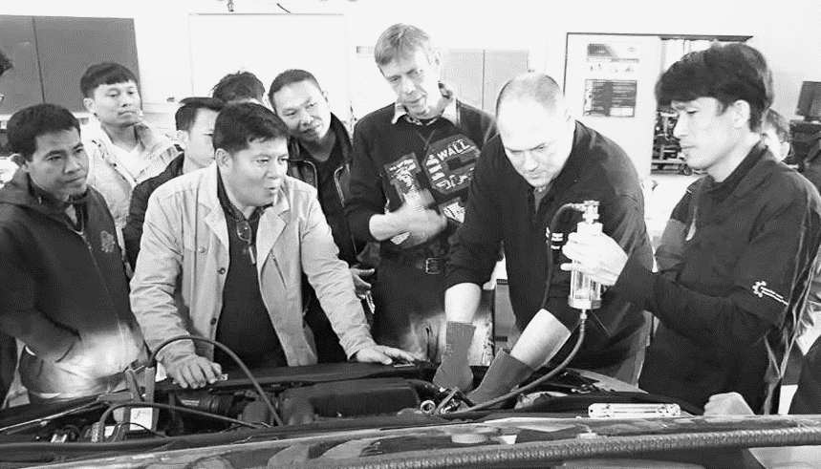
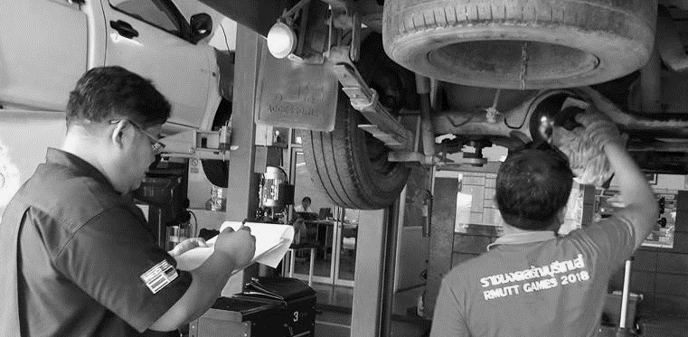
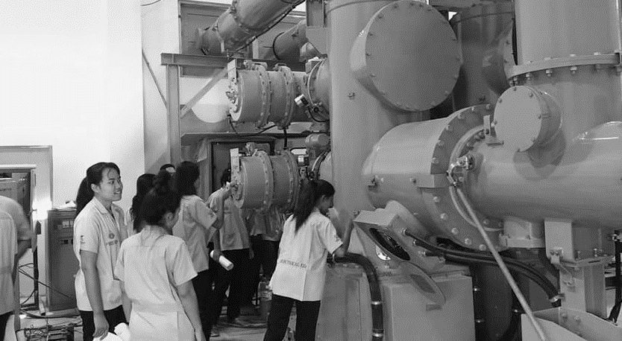
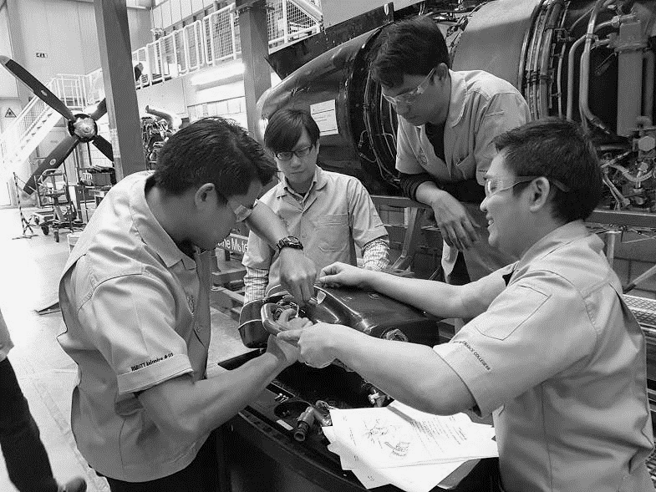
Indonesia Vocational Education & Training Summit (IVETS) 2019
9 – 10 October 2019 at Jakarta, Indonesia
“MEETING THE SOCIAL AND ECONOMIC NEEDS
OF THE ASEAN REGION THROUGH
AN EFFECTIVE VOCATIONAL TEACHER EDUCATION SYSTEM”
Asst. Prof. Pakornkiat Sawetmethikul, D. Eng.
Chairman – Regional Association of Vocational and Technical Education (RAVTE) in Asia
Vice Dean – Academic and Research Affairs, Faculty of Technical Education
Head of Research Unit – Applied Electromagnetics for Smart Forecast and Communication
Rajamangala University of Technology Thanyaburi (RMUTT), Thailand
E-mail: ravte.secretariat@gmail.com, pkkt@rmutt.ac.th

Slide 2
R A V T E
REGIONAL ASSOCIATION OF VOCATIONAL AND TECHNICAL EDUCATION IN ASIA
Hosted by
Rajamangala University of Technology Thanyaburi (RMUTT)
(Faculty of Technical Education as RAVTE Secretariat)
E-mail: ravte.secretariat@gmail.com

Slide 3
Vision and Mission:
RAVTE’s vision is an effective and harmonized TVET sector policy for the region. The policy strives to meet the demands and challenges of ASEAN integration processes, based on political consensus of all participating parties whilst referring to regional standards and quality criteria in the TVET sector. RAVTE’s mission is to emphasize the importance of TVET in general and VTE in particular at regional and national levels. RAVTE intends to support personnel development in order to enhance TVET quality and efficiency as well as fostering the ongoing integration activities and developments in East and Southeast Asian countries.
Objectives: Focusing on the demand of its member institutions with respect to
national and regional context.
Enhancing vocational teacher education (including institutional development)
Improving research activities on vocational education and to establish it as a scientific discipline
Fostering regionalization process and cooperation

Slide 4
RAVTE’s Organization:
Advisory Board (AB) : Thailand + German
Executive Board (EB) : President (RMUTT-Thailand) + EB members (RMUTT-Thailand + UTM-Malaysia + UPI-Indonesia + NUTE-Vietnam)
General Assembly Member (GAM) : ASEAN universities including
- 3 universities from Thailand - 3 universities from Malaysia
- 4 universities from Vietnam - 2 universities from Cambodia
- 1 university from Laos - 5 universities from Indonesia
- 2 universities from Philippines - 1 university from Singapore
- 5 universities from China + Taiwan
The total number of RAVTE member = 26 Institutions
Secretariat Office : Faculty of Technical Education, RMUTT-Thailand

Slide 5
Institution Member: General Assembly Member (GAM)
Cambodia (2)
- National Technical Training Institute (NTTI)
- National Polytechnic Institute of Cambodia (NPIC)
China (4)
- Beijing Normal University (BNU)
- Hong Kong Institute of Education (HKIE)
- Tongji University (IBB)
- Shenzhen Polytechnic (SZPT)
Indonesia (5)
- State University of Surabaya (UNESA)
- Universitas Pendidikan Indonesia (UPI)
- Yogyakarta State University (YSU)
- Universitas Negeri Jakarta (UNJ)
- Universitas Negeri Malang (UM)

Slide 6
Institution Member: General Assembly Member (GAM)
Laos (1)
- National University of Laos (NUoL)
Malaysia (3)
- Universiti Tun Hussein Onn Malaysia (UTHM)
- Universiti Tecknologi Malaysia (UTM)
- Universiti Pendidikan Sultan Idris (UPSI)
Philippines (2)
- University of San Carlos (USC)
- Imus Institute of Science and Technology (IMUS)
Singapore (1)
- Nanyang Polytechnic (NYP)

Slide 7
Institution Member: General Assembly Member (GAM)
Thailand (3)
- Rajamangala University of Technology Lanna (RMUTL)
- Rajamangala University of Technology Thanyaburi (RMUTT)
- Rajamangala University of Technology Krungthep (RMUTK)
Vietnam (4)
- Ho Chi Minh City University of Technology and Education
(HCMUTE)
- Namdinh University of Technology and Education (NUTE)
- Vinh Long University of Technology Education (VLUTE)
- Vinh University of Technology and Education (VUTED)
Taiwan (1)
- Southern Taiwan University of Science and Technology (STUST)

Slide 8
Partners / Networking (Intl.):
SEAMEO VOCTECH
UNESCO Regional office
ASEAN University Network (AUN)
Columbo Plan Staff College for Technicians Education (CPSC)

Slide 11
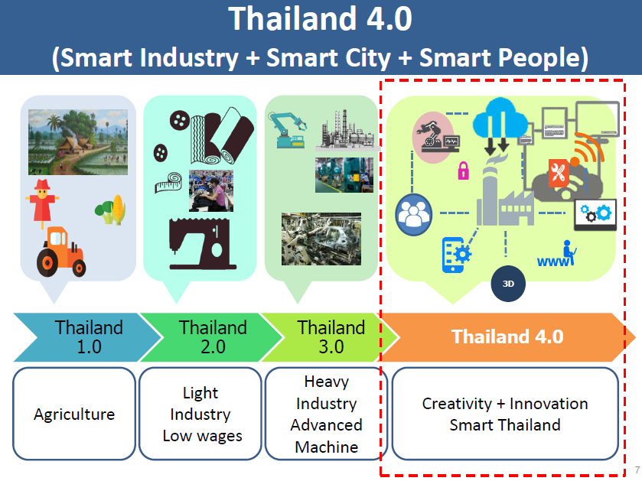

Slide 16
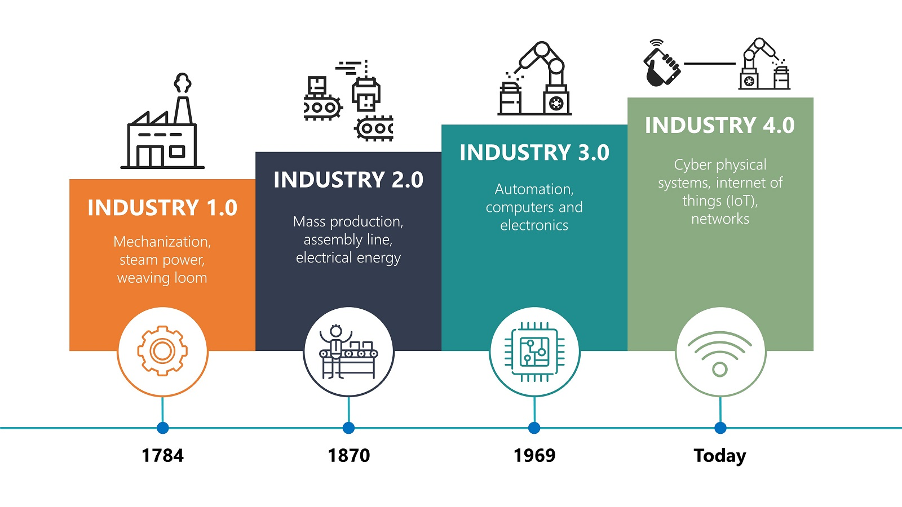
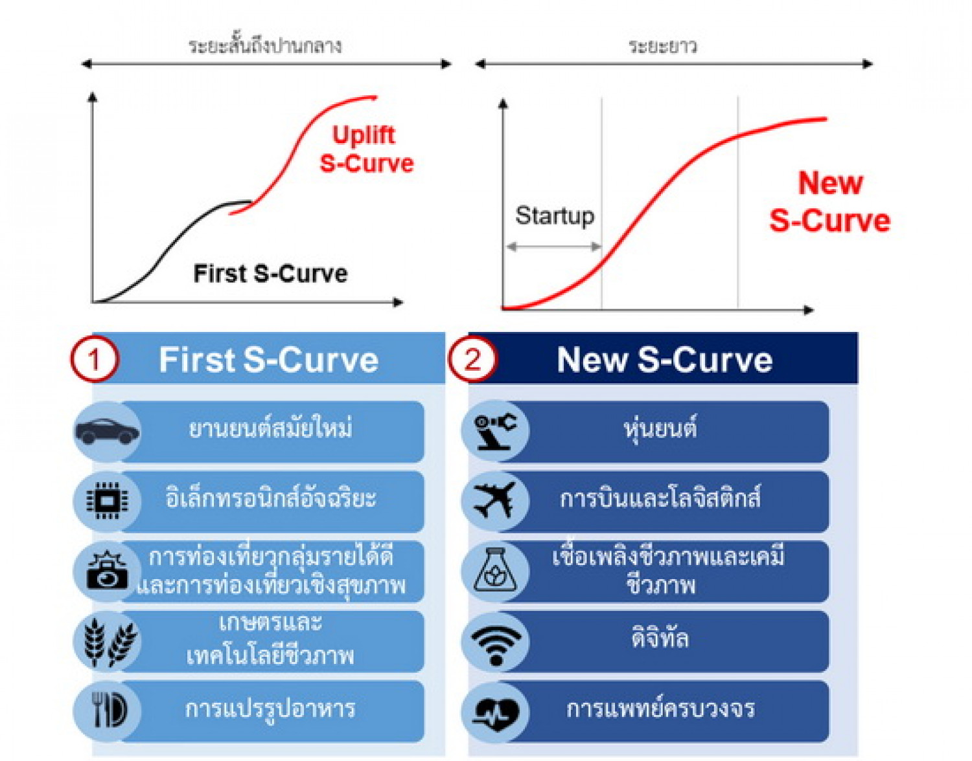
Demand Driven Education & Key Players
Thailand Growth Engines
Industry 4.0
Education Transformation
Academic Drivers
Partners / Networking
Human Resource Development
Robotics / Automation
10 + 2 S-Curves Demands
+
Area-Based Collaborative Development
Logistics (Aviation / Railway)
Demand Driven Edu.
OHEC + 7 RMUTs + 3 KMUTs + Min. Ed. + 429 OVECs
(Public)
Digital Literacy
Competency / Skill Standards
10 + 2 S-Curves
HRD Strategy
Smart Electronics
Biofuels & Biochemical
TPQI + DSD
International Standards & Institutions
Demand Driven Education & Training
+
Upskill/Reskill
Next-Gen Automotive
Smart Vocational Teacher → Smart Classroom & Academy → Smart Manpower (High-Skill / High Salary)
Education Sector (RMUTT + Networks)
Agriculture & Biotech.
Target Industries + Certification Organizations
Smart Trainer + Smart Workforce → Smart Factory →
Smart Industry 4.0 (Value-Added + High Income / GDP Growth)
Foods for Future
Digital Learning Platform for 21st Century → Capacity Building for All (Career Education + Smart People)
EEC + Gov. Supports & Local Organizations
Medical Hub
Smart Education + Digital Learning Platform
Smart People / Standard Skills
Smart Industry + GDP Growth
Tourism

Slide 17
5 Clusters for New Growth Industry in Thailand

Slide 18
Technology Transformation to Meet Smart Industry

Slide 20
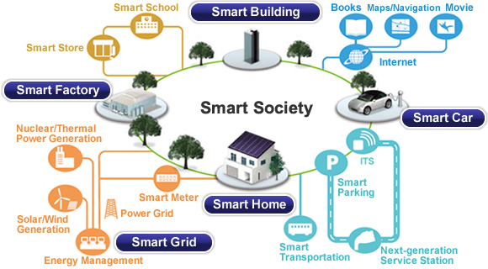
Smart Teacher
Smart Student
Smart University

Slide 21
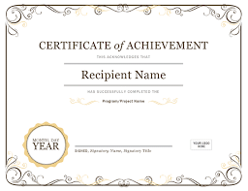
Competency-Based Curriculum Model : Competency + WIL
Soft Skills
Professional Standards +
Entrepreneur / Startup
Psychomotor Skills
Basic Professional Skills
Applied Professional Skills
Cert.
Working Experiences based WIL
(Work Integrated Learning)
Yearly Competency Test
(Equivalent Public Organization Standard)

Slide 22
